Slide 1
Exploring Factors Influencing Health and Lifestyle
Basit Shah
DS204 – Applied Data Science
May 30, 2025
Basit Shah | DS204 – Applied Data Science

Slide 2
Introduction
This project explores how sleep patterns, stress levels, and physical activity influence health outcomes.
We used real-world data to test hypotheses and identify important health predictors.
Basit Shah | DS204 – Applied Data Science

Slide 3
Dataset Overview
• Source: Kaggle Sleep Health & Lifestyle Dataset
• Fields: Age, Gender, Sleep Duration, Stress, Activity, Heart Rate, BMI
• 374 individuals with mixed lifestyle and health factors
Basit Shah | DS204 – Applied Data Science

Slide 4
Key Findings & Interpretations
• People with sleep disorders sleep ~0.5 hrs less (p < 0.001)
• Stress levels differ by BMI category (ANOVA, p < 0.01)
• Strong negative correlation: Stress vs. Sleep Quality (τ = -0.826)
Basit Shah | DS204 – Applied Data Science

Slide 5
Real-World Implications
• Promote stress-reduction to improve sleep & heart health
• Sleep disorder screening should be a routine wellness measure
• Encourage balanced activity for BMI and stress support
Basit Shah | DS204 – Applied Data Science

Slide 6
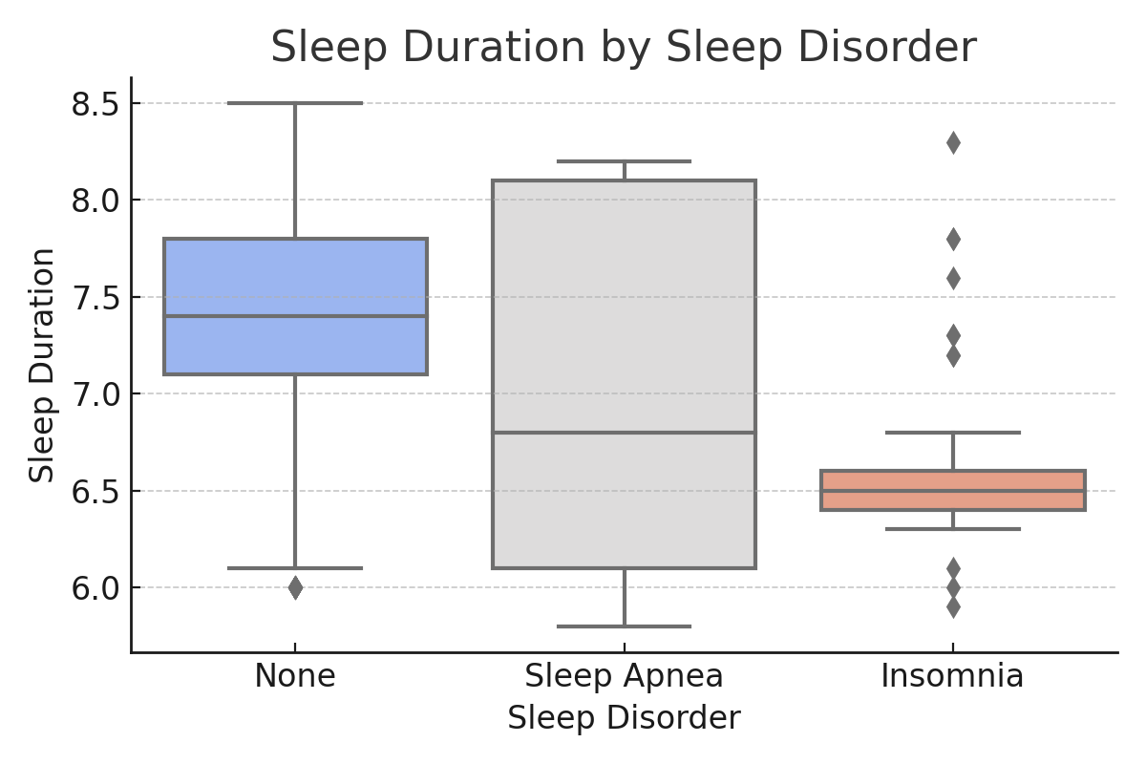
Sleep Duration by Sleep Disorder
People diagnosed with sleep disorders tend to sleep less on average compared to those without disorders.
Basit Shah | DS204 – Applied Data Science

Slide 7
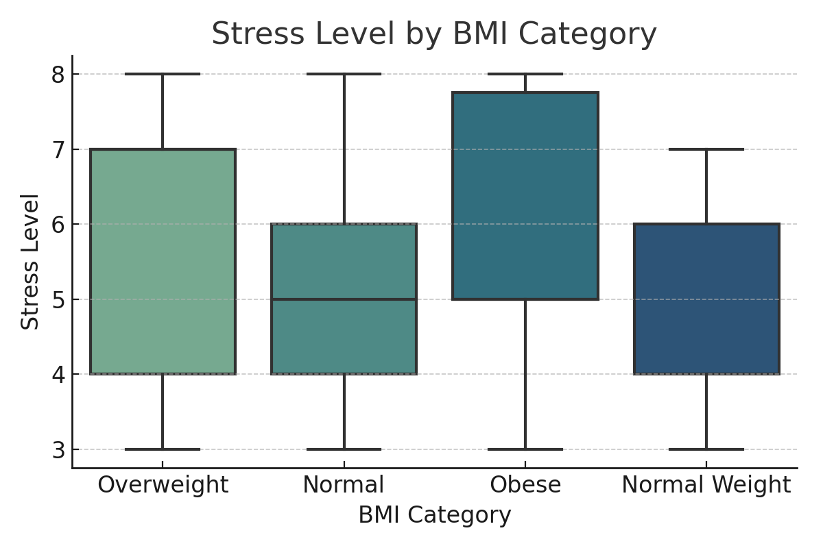
Stress Level by BMI Category
Higher BMI categories show a noticeable increase in average stress level, indicating a potential link.
Basit Shah | DS204 – Applied Data Science

Slide 8
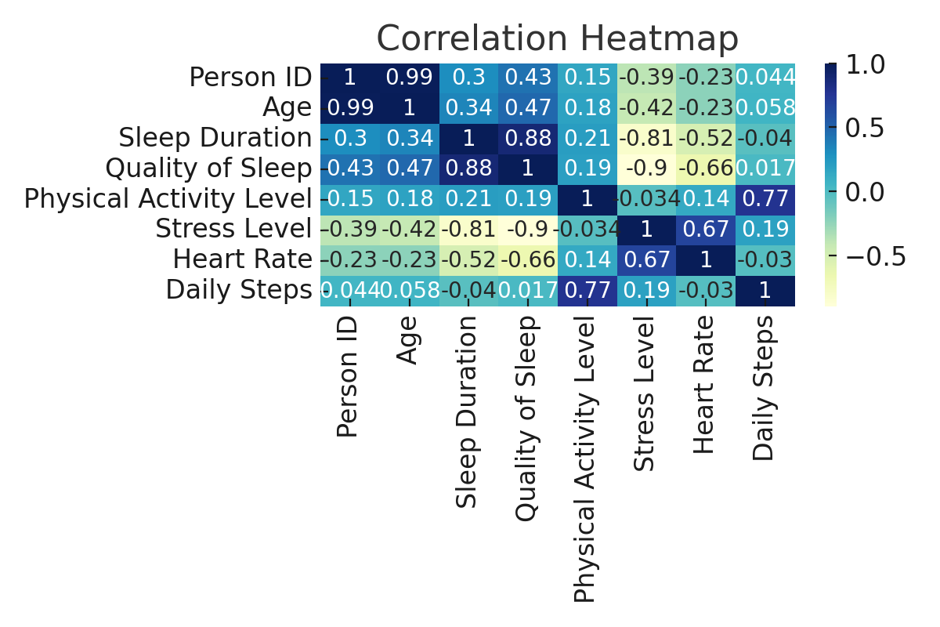
Correlation Heatmap of Key Variables
Correlation heatmap reveals strong negative correlation between stress and sleep quality, and moderate links with heart rate.
Basit Shah | DS204 – Applied Data Science

Slide 9
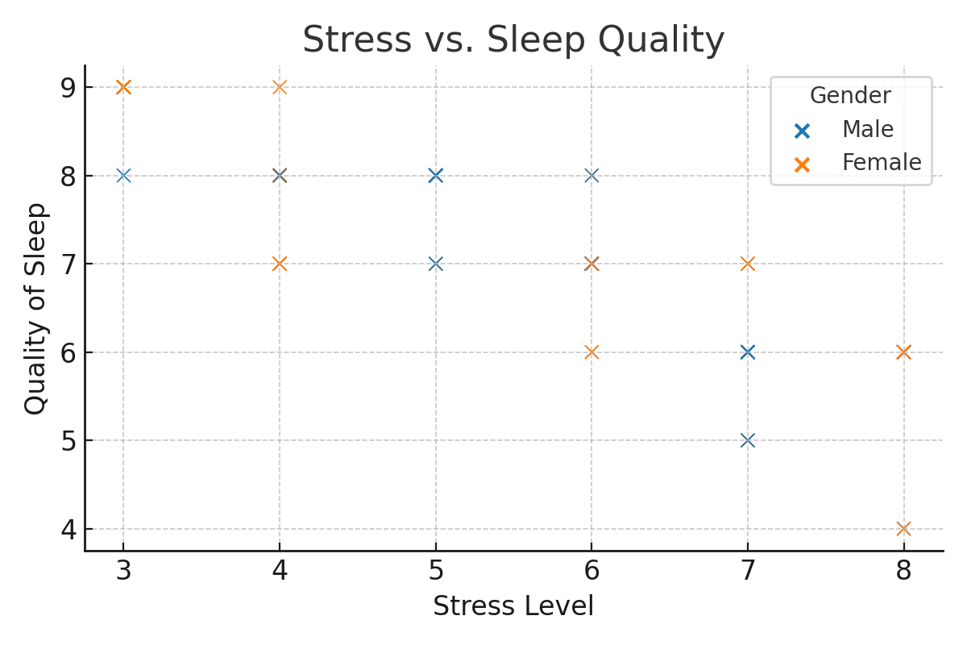
Stress vs Sleep Quality Scatterplot
Scatterplot shows an inverse trend: as stress levels rise, sleep quality tends to decrease, with differences across genders.
Basit Shah | DS204 – Applied Data Science

Slide 10
Conclusion
• Sleep, Stress, and BMI are powerful predictors of health
• Data science reveals measurable impacts from lifestyle choices
• Future research should combine mental and physical wellness dimensions
Any questions? Don’t hesitate to to ask.
Basit Shah | DS204 – Applied Data Science

